Slide 1

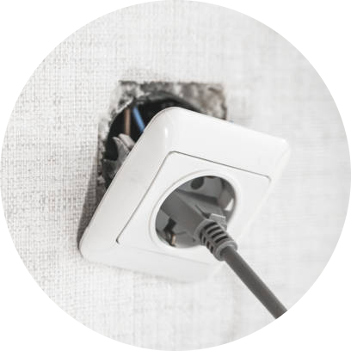

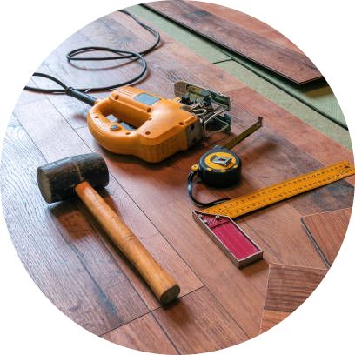


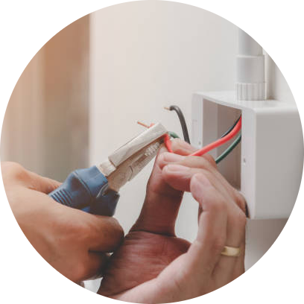


The Craftsmen

Slide 2










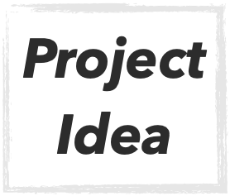
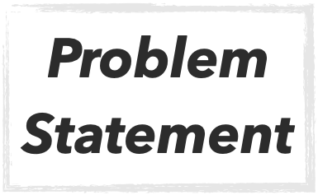
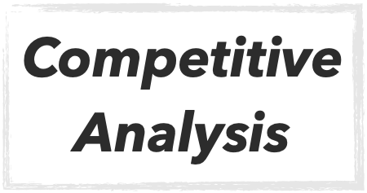
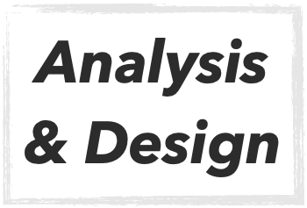





Content
Notes:
Analysis: Functional & nonFunctional Requirements
Design: names of Diagrams Implementation : tools(front-END & Back-end)
ML model
Testing

Slide 3

Project Idea

Slide 4

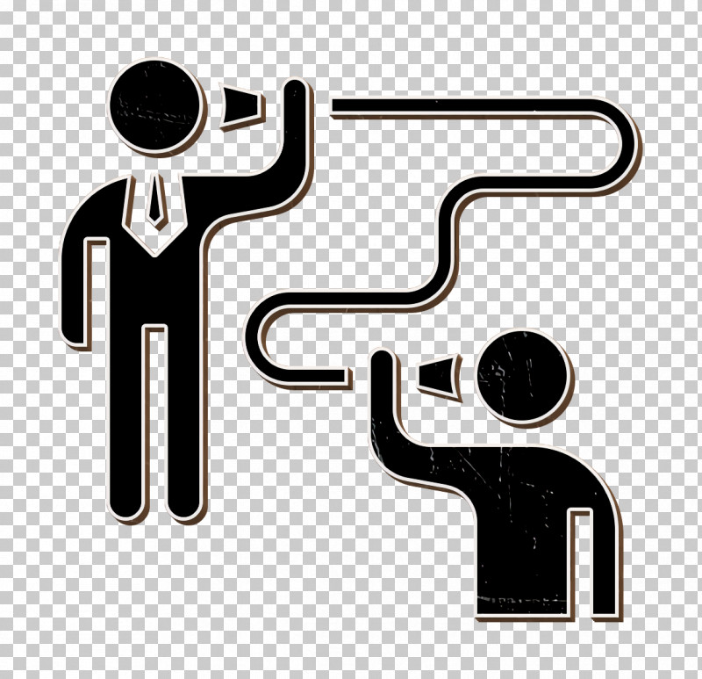



Project Idea
Search for a craftsman to solve his problem
Craftsman can solve the problem
Communicate with the craftsman
User has a problem

Slide 5





Problem Statement
Difficulty to Find a craftsmen
Difficulty to Communicate with the craftsmen
Difficulty to find Professional craftsmen
Difficulty to get a Faster one & closest distance (Location)

Slide 6


Competitive Analysis

Slide 7









Logo | Name | In Egypt | Choose Craftsman | Notification | Chat | Rate | Feadback
 | Elherafyeen
 | CRAFTSMAN myQ
 | Craftnote
 | CRAFTSMAN
 | Primo
 | The craftsmen

Slide 8

Analysis & Design

Slide 9
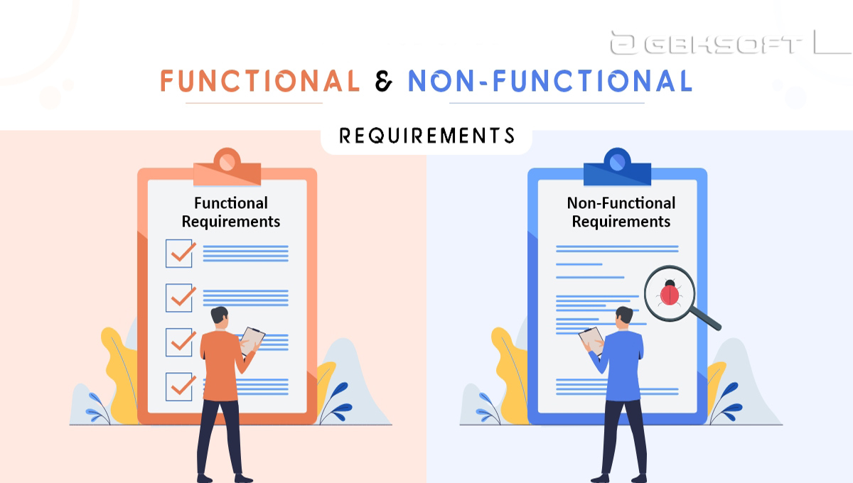
Analysis

Slide 10
Functional Requirement
User | Craftsmen
Sign up & Sign-in
Logout
Delete account
Password reset
Edit profile
Notification
Chat
Send request | View request Accept & Reject Request
View craftsman work | Add work & Delete work
Write feedback | View the feedback
Non-functional Requirement
Usability
Reliability
Performance
Scalability
Availability
Data integrity
Maintainability & Flexibility

Slide 11


Design
UML Diagrams
Behavior Diagrams
Structure Diagrams
Use case
Class
Activity
Sequence
State machine

Slide 12







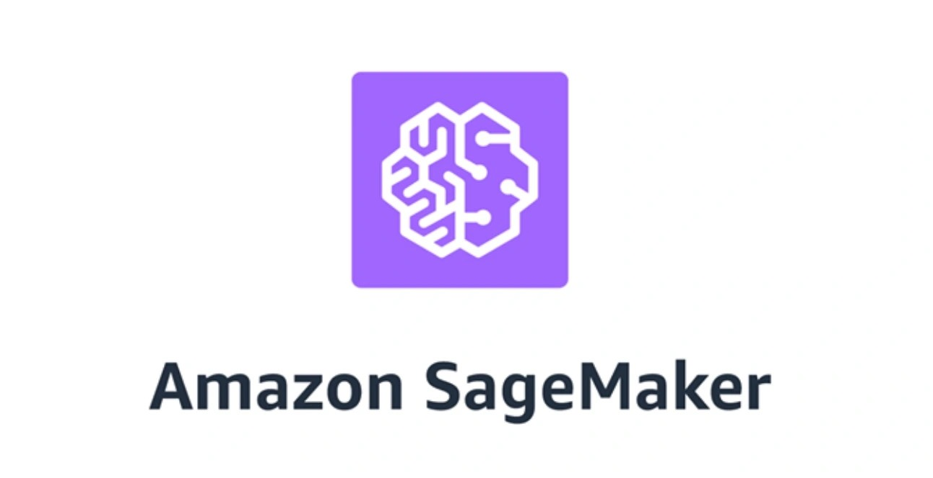

TOOLS
Notes:
DBMS

Slide 13


Implementation

Slide 14

Problem definition
Input
Output
Black box
0 for positive
1 for negative
User feedback (text)
Binary Classification task

Slide 15
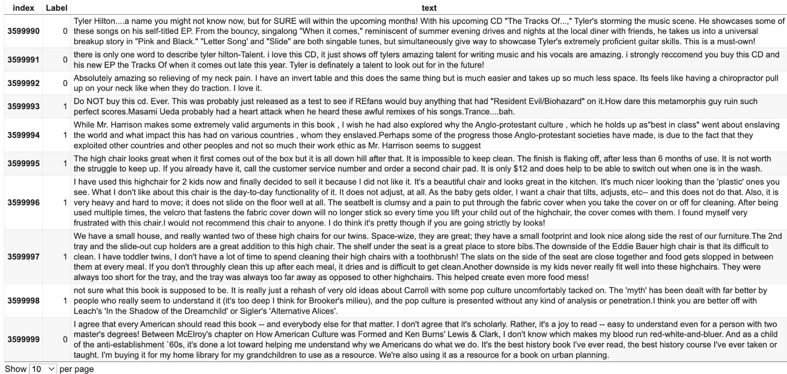
Dataset sample

Slide 16
Data collection
Data
Training
Validation
Testing
60 %
20 %
20 %
Learn model
Hyperparameter Tuning
Evaluation
Notes:
Data (training - Validation - testing)
Epoch
Training lose / validation lose

Slide 17
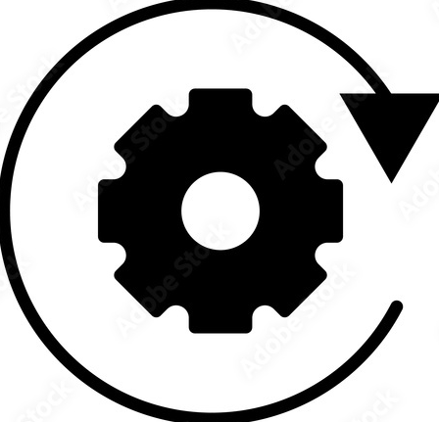
Pre-processing
Tokenization
convert text inputs to numerical data
Notes:
(BERT -> RoBERTa) “Encoders”

Slide 18
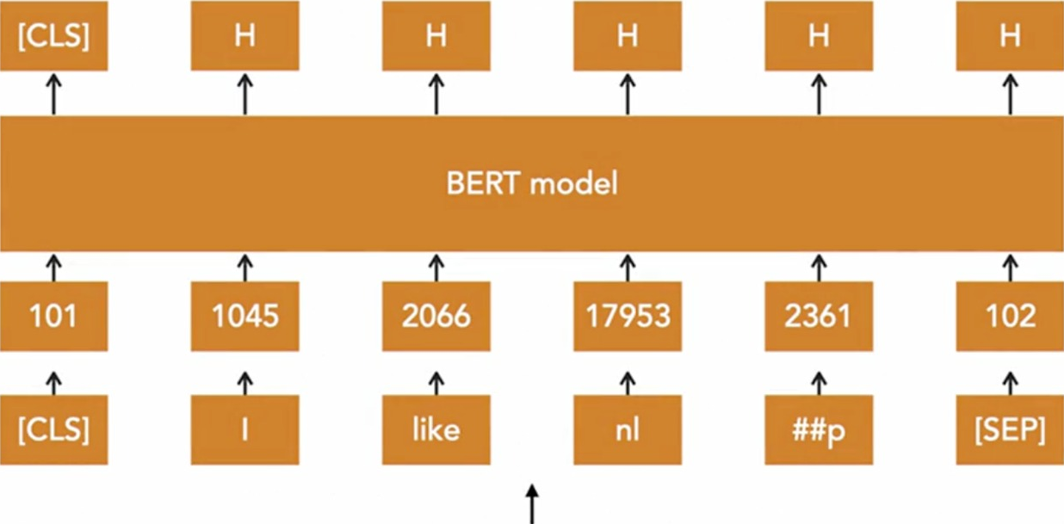

Tokenization
convert text inputs to numerical data
Hidden States
RoBERTa model
Input word IDs
Tokens
“I like nlp
Input text
Notes:
"CLS" = “classification" : beginning of the input sequence
"SEP" (separator) : - mark boundaries between sentences or segments - padding tokens to ensure uniform sequence length
RoBERTa : Robustly Optimized BERTBi-directional Encoder Representation from Transformer
RoBERTa : language model - by Facebook
12 encoder & Usually 512 vector

Slide 19
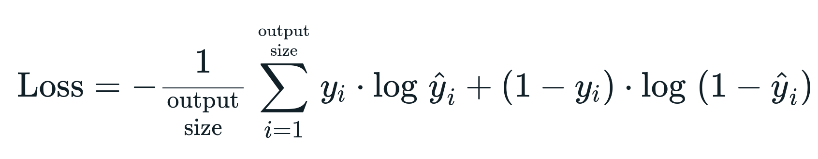
Training
1- Binary Cross Entropy Loss (Binary classification task)
Where:
Loss : is the binary cross-entropy loss
y : is the true label (0 or 1)
y^ : is the predicted probability

Slide 20
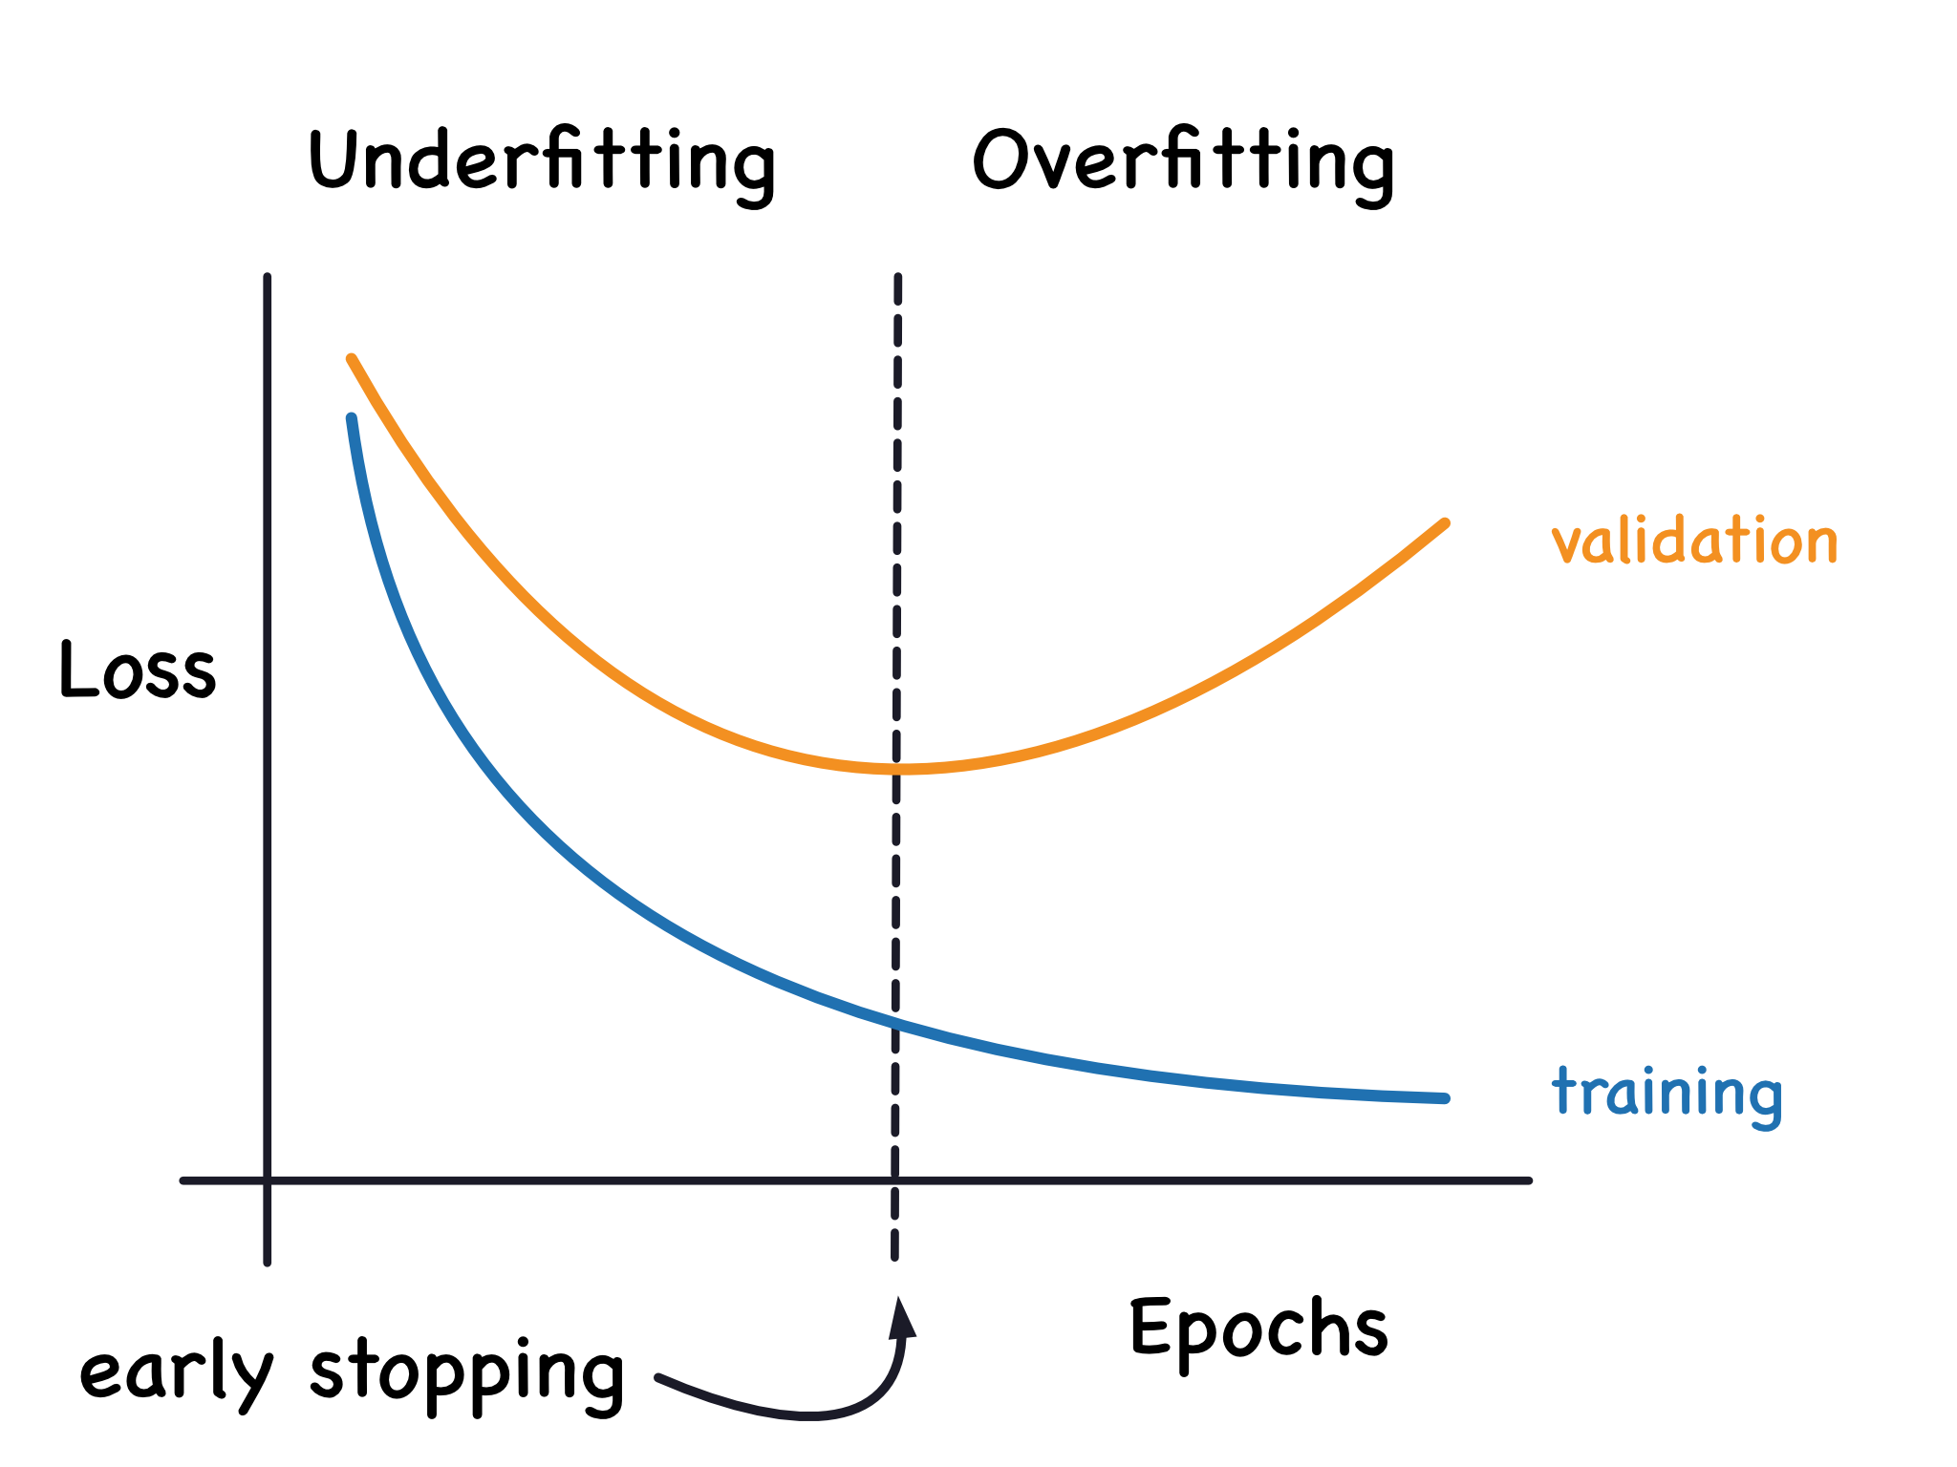
Validation

Slide 21
Evaluation (Testing)
Testing
Accuracy
Precision
recall
F1 score
True predictions
True Positives
Total number of predictions
True Positives + False Negatives
True Positives
2 * (precision * recall)
True Positives + False Positives)
(precision + recall)
Notes:
accuracy, precision, recall, F1 score
Accuracy = (True predictions ) / (Total number of predictions)
Precision = True Positives / (True Positives + False Positives)
Recall = True Positives / (True Positives + False Negatives)
F1 score = 2 * (precision * recall) / (precision + recall)

Slide 22

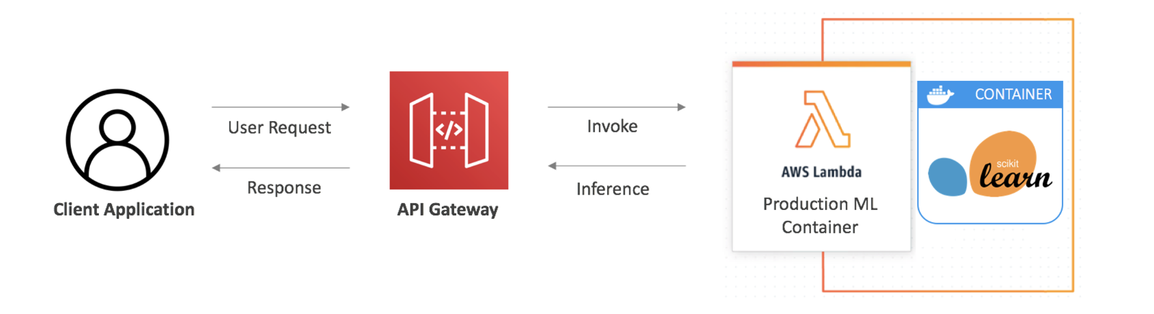
Deployment
User Request
Invoke
Model
Endpoint
Client Application
Response
Inference
API Gateway
Notes:
Lamda function: Preprocessing of user input
: invoke the endpoint

Slide 23
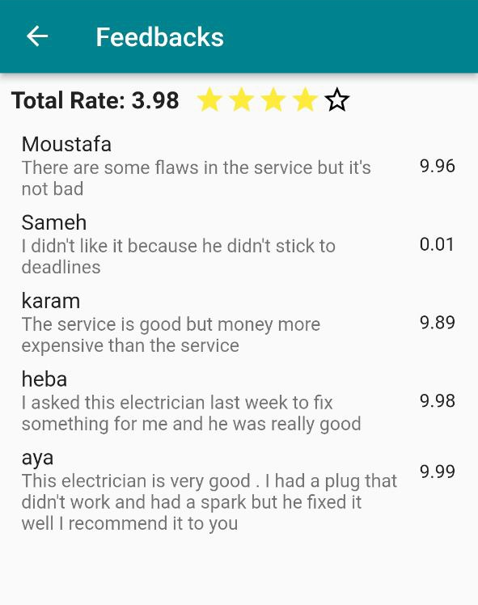
Final output

Slide 24

Demo

Slide 25

THE
FUTURE
OF WORK

Slide 26
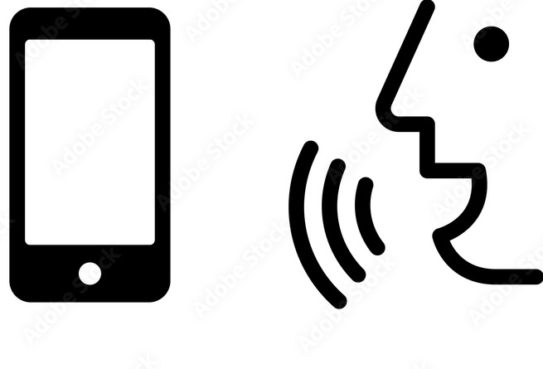

Using voice
To explain the problem

Slide 27



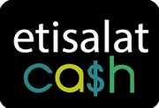

Pay
Online
Notes:
Make the process of payment easy and flexible

Slide 28

Building
Chat BOT
Notes:
This BOT can help user to identify his problem and solve it if it possible
OR Recommend a craftsmen to user

Slide 29




Store

Slide 30

Conclusion
User can find Professional craftsmen & Fast (closest distance)
User can choose craftsman according Rate
User can Communicate with the craftsmen
User can give a feedback for a craftsman work

Slide 31



